Slide 1

Artificial Intelligence in Education
How Smart Systems are Transforming Learning

Slide 2






What is AI in Education?
Intelligence Simulation
AI simulates human intelligence in machines to enhance learning experiences.
Personalized Learning
Tailors educational content to individual student needs and pace.
Automation
Automates grading and administrative tasks, saving educators time.
Performance Analysis
Analyzes student data to improve outcomes and identify challenges.

Slide 3

Evolution of AI in Education
1
Early 2000s
E-learning platforms emerged (Moodle, Blackboard)
2
2010s
AI and data analytics began integrating into education
3
Today
Intelligent tutoring systems and adaptive learning platforms are widespread

Slide 4

How AI Powers Modern Learning
Machine Learning
Analyzes student data to make predictions and personalize content delivery.
Natural Language Processing
Enables chatbots to interact naturally with learners, answering questions instantly.
Data Analytics
Identifies learning patterns and challenges to optimize educational strategies.

Slide 5

AI Tutoring Systems
Carnegie Learning
Squirrel AI
Duolingo
Personalized math instruction system
Intelligent adaptive learning platform
Adaptive language learning platform
These systems provide personalized guidance, adjusting content based on individual performance to maximize learning efficiency.

Slide 6
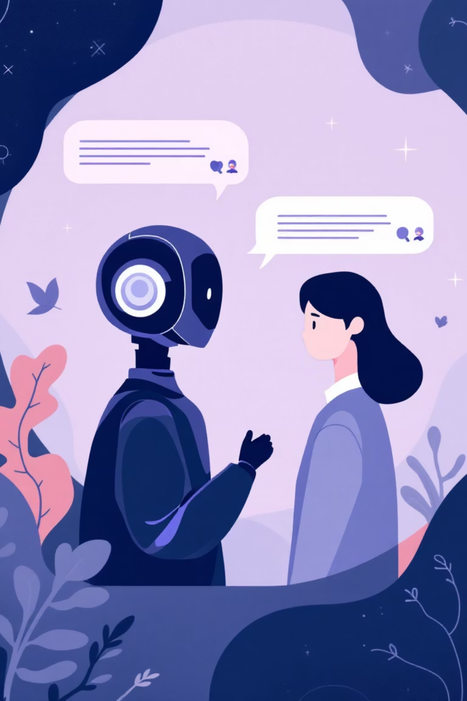
Chatbots Revolutionizing Student Support
Instant Answers
Reduced Workload
Students receive immediate responses to questions 24/7, eliminating wait times.
Teachers and administrators save time on routine inquiries and tasks.
Real-World Example
ChatGPT-based virtual assistants are now deployed in universities worldwide.

Slide 7



Ensuring Academic Integrity
AI-Powered Plagiarism Detection
AI tools detect similarities in academic work, promoting originality and honesty.
Turnitin
Grammarly
Industry-leading similarity checker
Writing enhancement and originality verification
Copyleaks
Advanced plagiarism detection platform

Slide 8
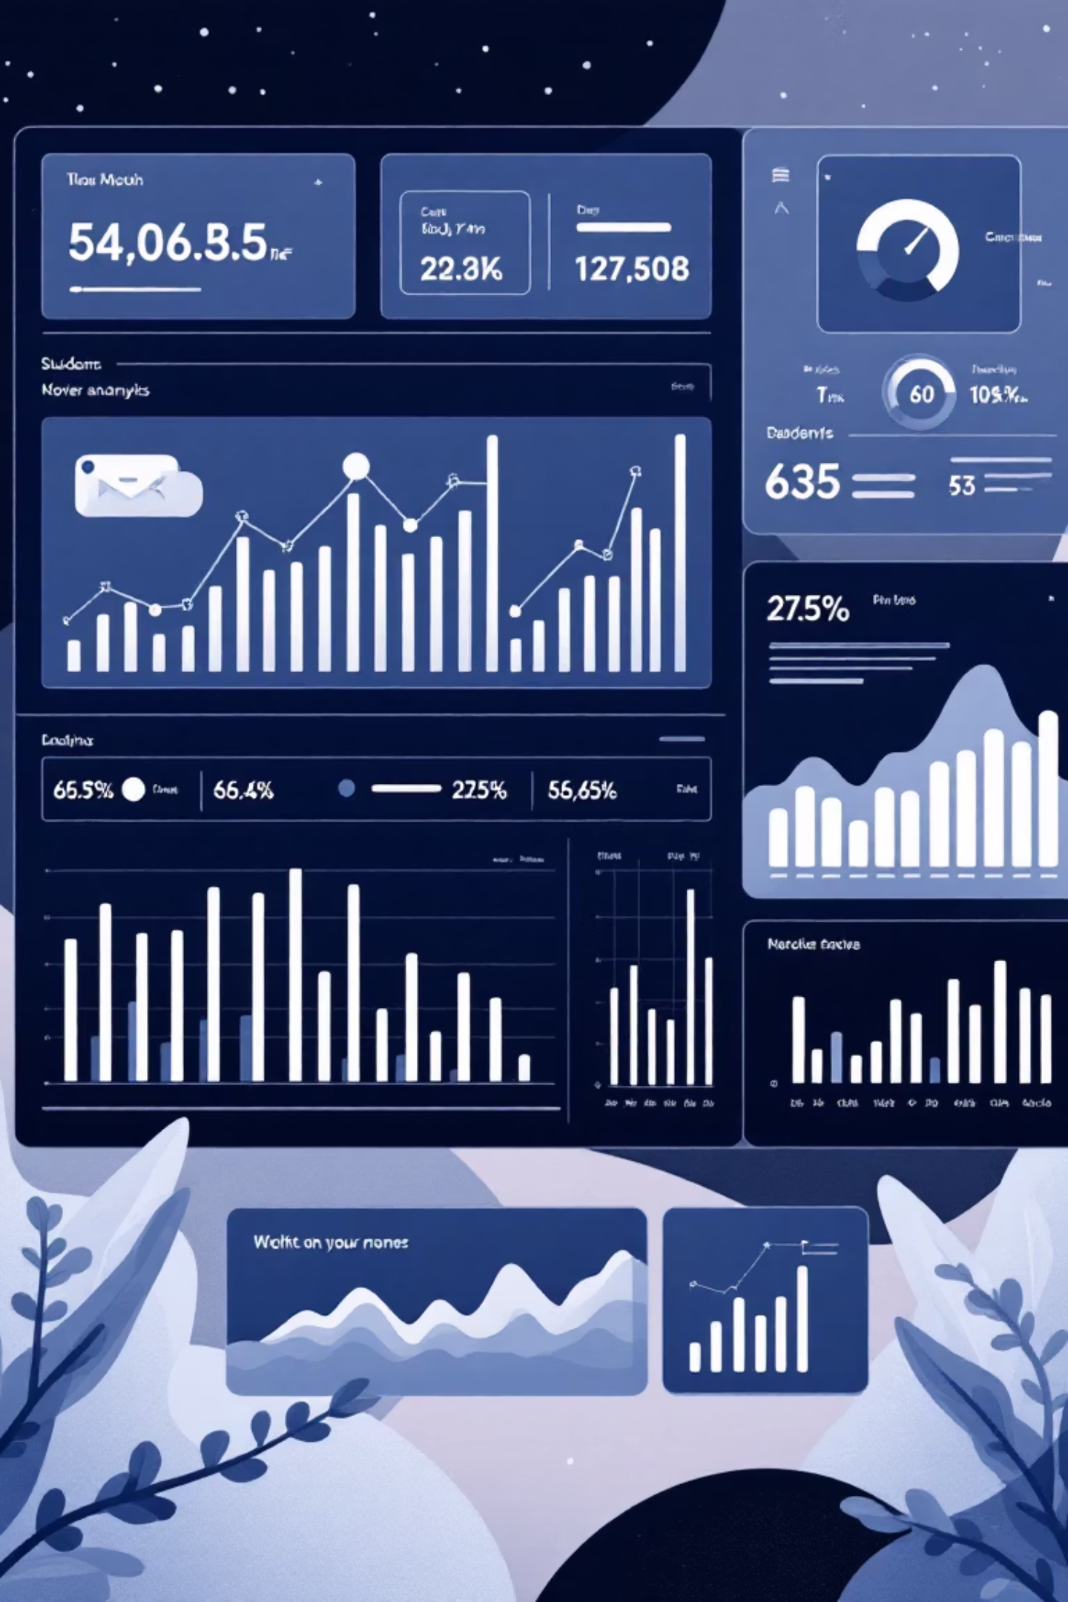



Data-Driven Educational Insights
Data Collection
AI analyzes large amounts of student data from multiple sources
Early Identification
Identifies struggling students early for timely intervention
Informed Decisions
Enables teachers to make data-driven instructional decisions

Slide 9


Challenges to Address
1
2
Data Privacy & Security
Algorithmic Bias
Protecting sensitive student information from breaches and misuse.
Ensuring AI systems don't perpetuate or amplify existing inequalities.
3
4
Technology Dependence
Implementation Costs
Balancing AI tools with human interaction and traditional teaching methods.
High expenses create barriers for under-resourced schools and institutions.

Slide 10

The Future of AI in Education
Inclusive Learning
More personalized environments adapting to diverse learning needs and styles.
Immersive Technologies
Integration with virtual and augmented reality for experiential learning.
AI Companions
AI teachers and lifelong learning companions supporting continuous education.
AI is transforming education through personalization, automation, and analytics—making learning more efficient and inclusive. Ethical use and proper implementation are key to success.

